Slide 1
COMP5703
KINDER FOOD FINDER SYSTEM
Kinder Food Finder Group 2

Slide 2

TABLE OF CONTENT
1. | PROJECT BACKGROUND
2. | KINDER FOOD FINDER SYSTEM
3 | MOBILE APPLICATION
4 | WEB-PAGE SERVER
5. | CONCLUSION/ NEXT STEPS

Slide 3
TABLE OF CONTENT
1. | PROJECT BACKGROUND
2. | KINDER FOOD FINDER SYSTEM
3 | MOBILE APPLICATION
4 | WEB-PAGE SERVER
5. | CONCLUSION/ NEXT STEPS

Slide 4
1
PROJECT BACKGROUND
Introduction to the project (1/2)
PROJECT
KINDER FOOD FINDER SYSTEM
Animal welfare refers to how animals or livestock is coping with the conditions in which they live.
Farmstead that provide decent living condition for livestock is acknowledged as “animal-friendly”
More and more people wants to provide support for the animal welfare movements.
Standards by animal welfare organizations help consumers to identify animal-friendly brand.

Slide 5
1
BACKGROUND
Introduction to the project (2/2)
Access to transparent and accurate animal-welfare information is a complicated process.
Objective and Deliverable
Using Information Technology to produce a system that grants users access to information regarding animal-welfare matter of different brands in an efficient way.
Ambiguous product labelling;
False advertising;
Time consuming (For shoppers);
Lack of connection between organizations and individual

Slide 6
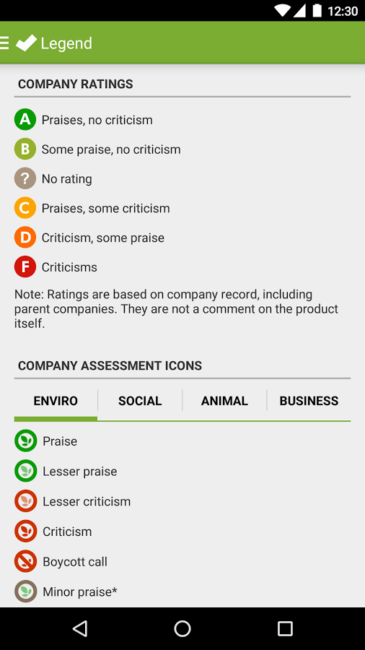
1
BACKGROUND
Related works (1/2) – Shop ethical!
Shop ethical!
Mobile application
Provide users with ethical information of the several companies (Not ethics of the product)
Support users making purchasing decision.
Cover multiple product categories: Food & Drink, Baby, Clothing, Pet, Retail, Toys, etc.
Figure 1. Shop ethical! app

Slide 7
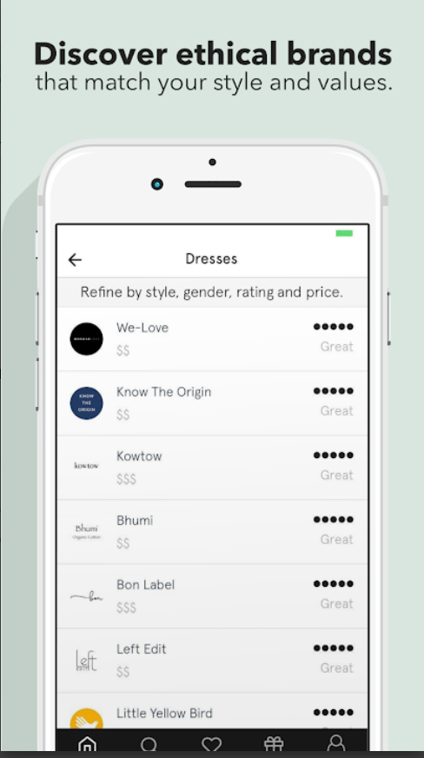
1
BACKGROUND
Related works (2/2) – Good on you!
Good on you
Mobile application
Users can access ethical rating of fashion brands.
Rating is determined by how the brand involves in: pollution, waste, human and animal welfare.
Figure 2. Good on You app

Slide 8
TABLE OF CONTENT
1. | PROJECT BACKGROUND
2. | KINDER FOOD FINDER SYSTEM
3 | MOBILE APPLICATION
4 | WEB-PAGE SERVER
5. | CONCLUSION/ NEXT STEPS

Slide 9
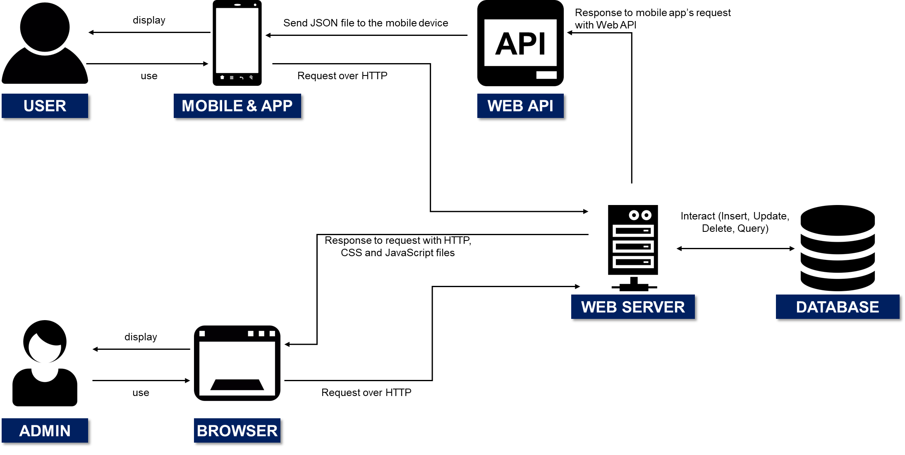
2
KINDER FOOD FINDER SYSTEM
System architecture
Kinder Food Finder system consists of two important parts: (1) Mobile application and (2) Web-page server
Figure 1. Architecture of the system

Slide 10
2
KINDER FOOD FINDER SYSTEM
Requirements for the system
MOBILE APPLICATION
Search/ browse function that displays animal-welfare rating of different brands;
Locate and Report function enables users inform others and to find where to buy a brand;
Collect statistical data from users (i.e. How many times a brand is searched)
SERVER
Database management functions: insert, query, delete, update;
Able to communicate with the mobile app (Receive and send data);
Summarize and display statistical data.

Slide 11
TABLE OF CONTENT
1. | PROJECT BACKGROUND
2. | KINDER FOOD FINDER SYSTEM
3 | MOBILE APPLICATION
4 | WEB-PAGE SERVER
5. | CONCLUSION/ NEXT STEPS

Slide 12
3
MOBILE APPLICATION
Technologies
Languages: JAVA
Software: Android Studio
Third Party Libraries and Tools
Facebook Login— User login;
Google play services: Maps—location implementation;
Volley— Internet implementation;
Picasso—image load and cache;
Gson— JSON file parse;

Slide 13
3
MOBILE APPLICATION
Main features
Search for rating by brand or accreditation
Browse a rating by category, accreditation, and rating
Report a Store Feature
Data Interaction Feature
Location Feature

Slide 14
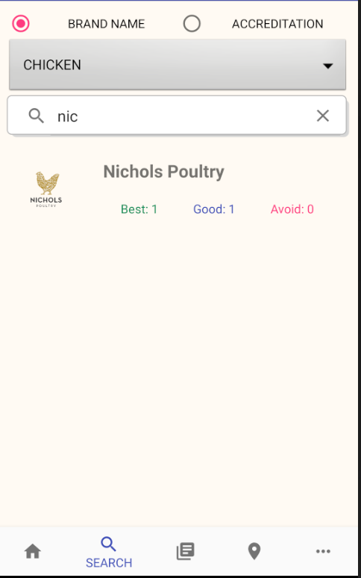
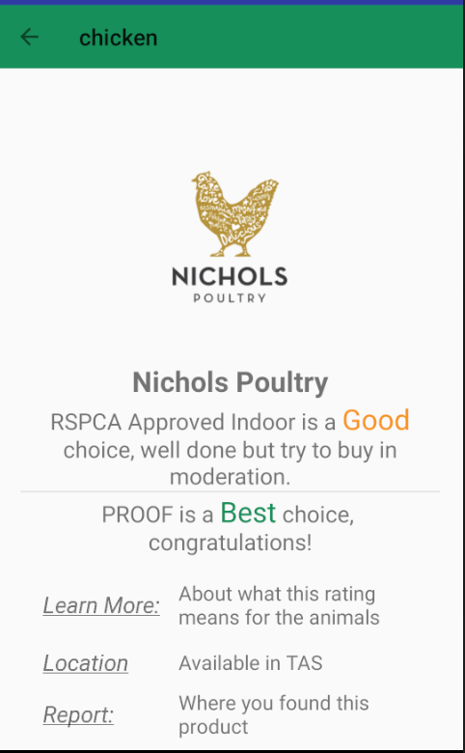
3
MOBILE APPLICATION
Search feature by brand name
Select search type
Select Product category
Search by Brand Name
Brand name
Multiple Accreditation and Rating

Slide 15
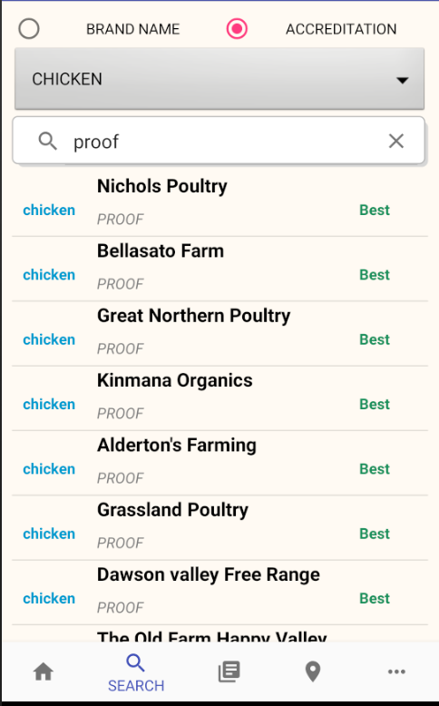
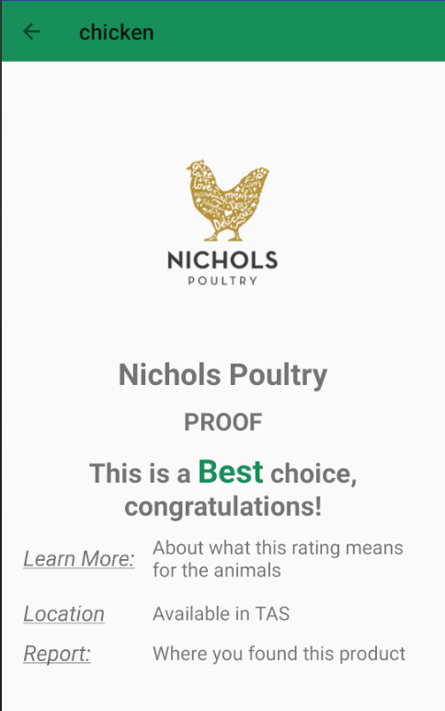
3
MOBILE APPLICATION
Search feature by accreditation
Select search type
Select Product category
Search by Accreditation
Accreditation
One Accreditation and Rating

Slide 16
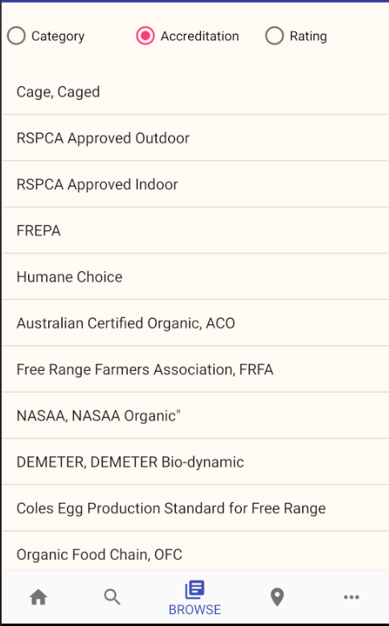
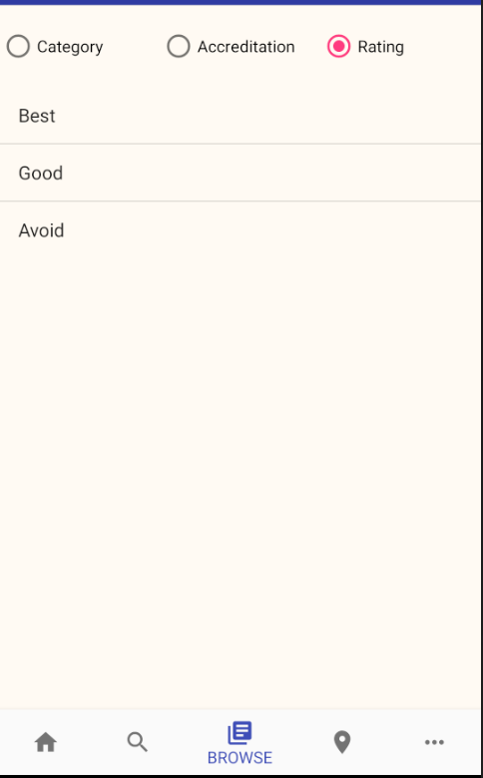
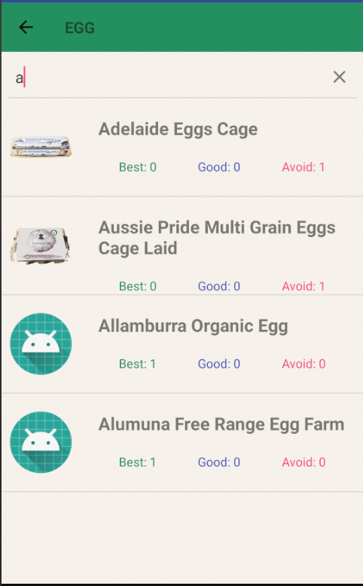
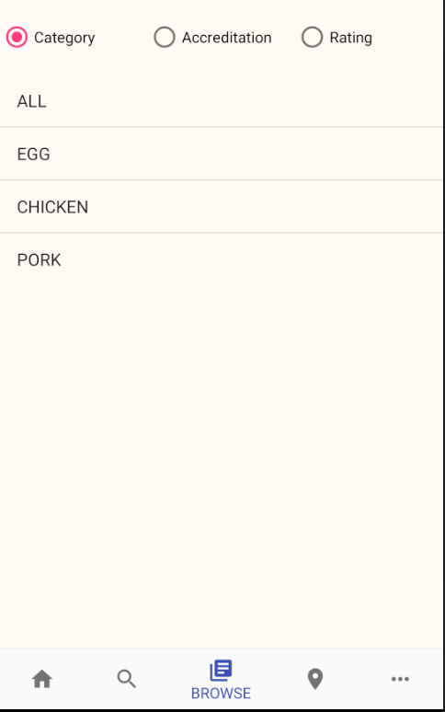
2
MOBILE APPLICATION
Browse feature
Search by Brand Name

Slide 17
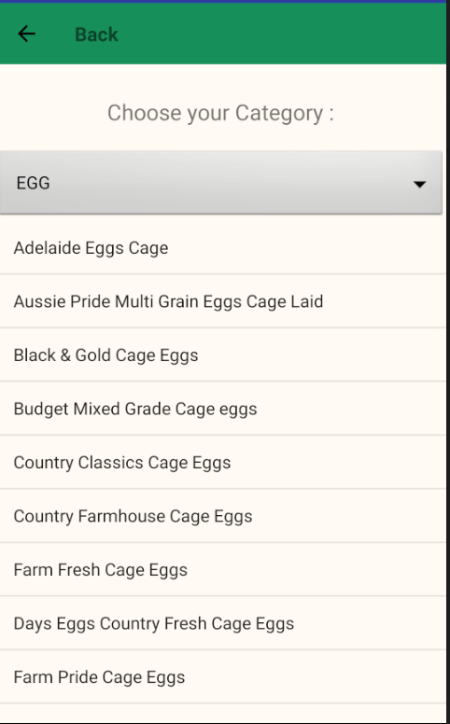
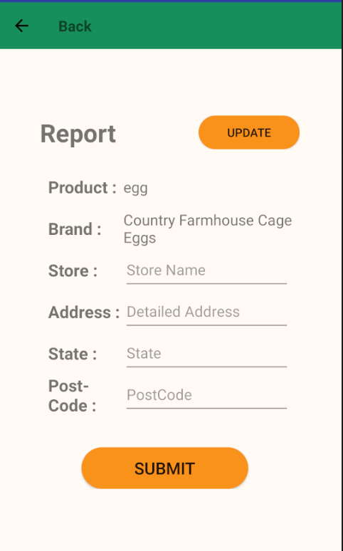
3
MOBILE APPLICATION
Report feature
Select Product category
Fill up Store Information

Slide 18
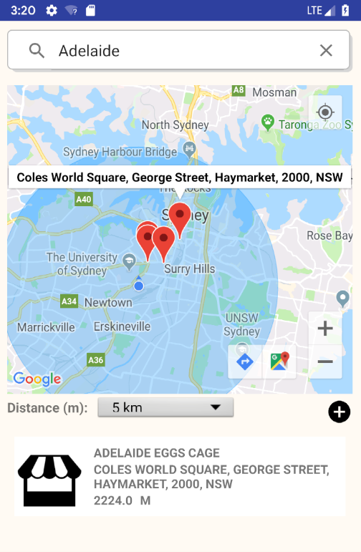
3
MOBILE APPLICATION
Locate feature
Select Product category
Store detailed information
Distance Circle
Change the distance
Report the product you found
The store information list including brand name, store name and distance

Slide 19

3
MOBILE APPLICATION
Data interaction
Data Connection
Application
Server
Login and register request;
Check database request;
Report store request;
Send statistics request;

Slide 20
TABLE OF CONTENT
1. | PROJECT BACKGROUND
2. | KINDER FOOD FINDER SYSTEM
3 | MOBILE APPLICATION
4 | WEB-PAGE SERVER
5. | CONCLUSION/ NEXT STEPS

Slide 21
4
WEB-PAGE SERVER
Technologies
Languages: Node JS & Express
Software: WebStorm or IntelliJ
Database: MongoDB

Slide 22
4
WEB-PAGE SERVER
Main features
Statistics
Report
Import & Insert Data
Update & Delete Brand/Store
Publish

Slide 23
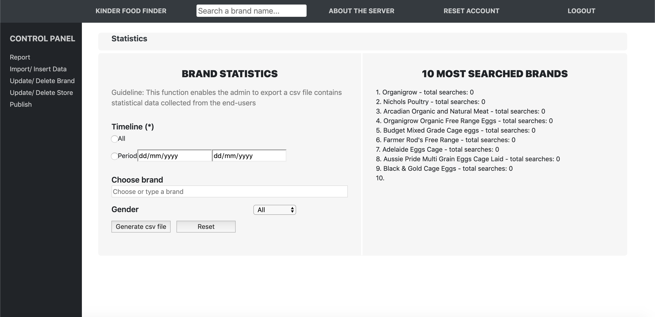
4
WEB-PAGE SERVER
Statistics feature
Admin can generate the statistic data based on the chosen timeline, brand, and gender.

Slide 24
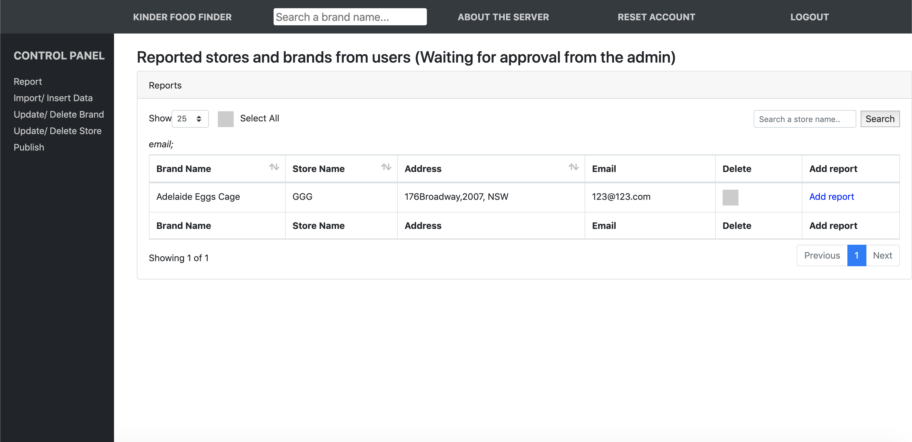
4
WEB-PAGE SERVER
Report feature (1/2)
Admin can decide if the reported store should be added or removed based on its correctness.

Slide 25
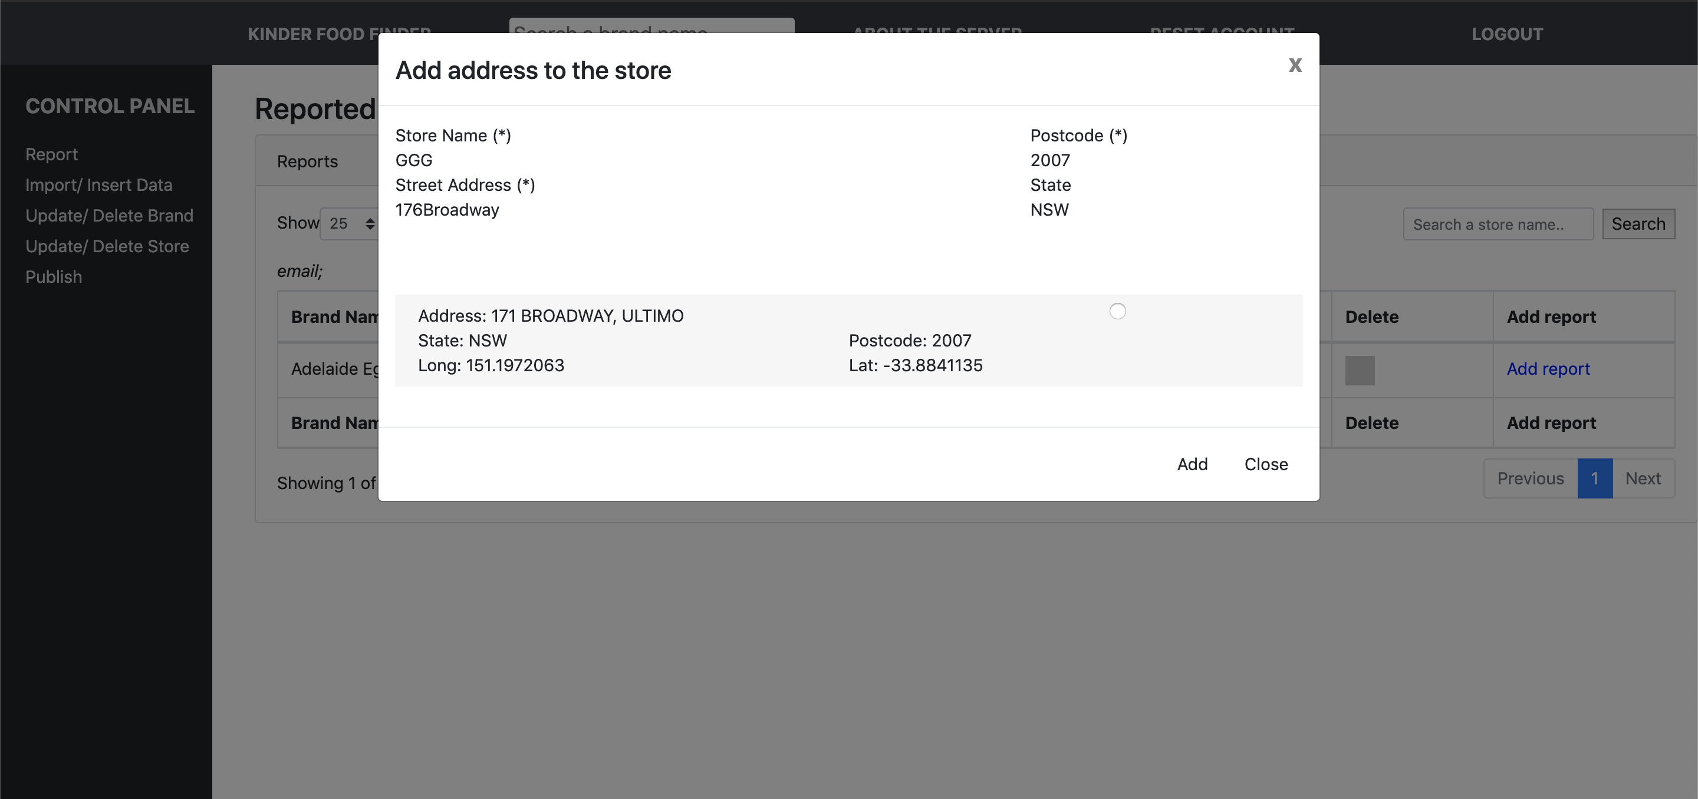
4
WEB-PAGE SERVER
Report feature (2/2)
Admin can have choices of optimized addresses based on the given address.

Slide 26
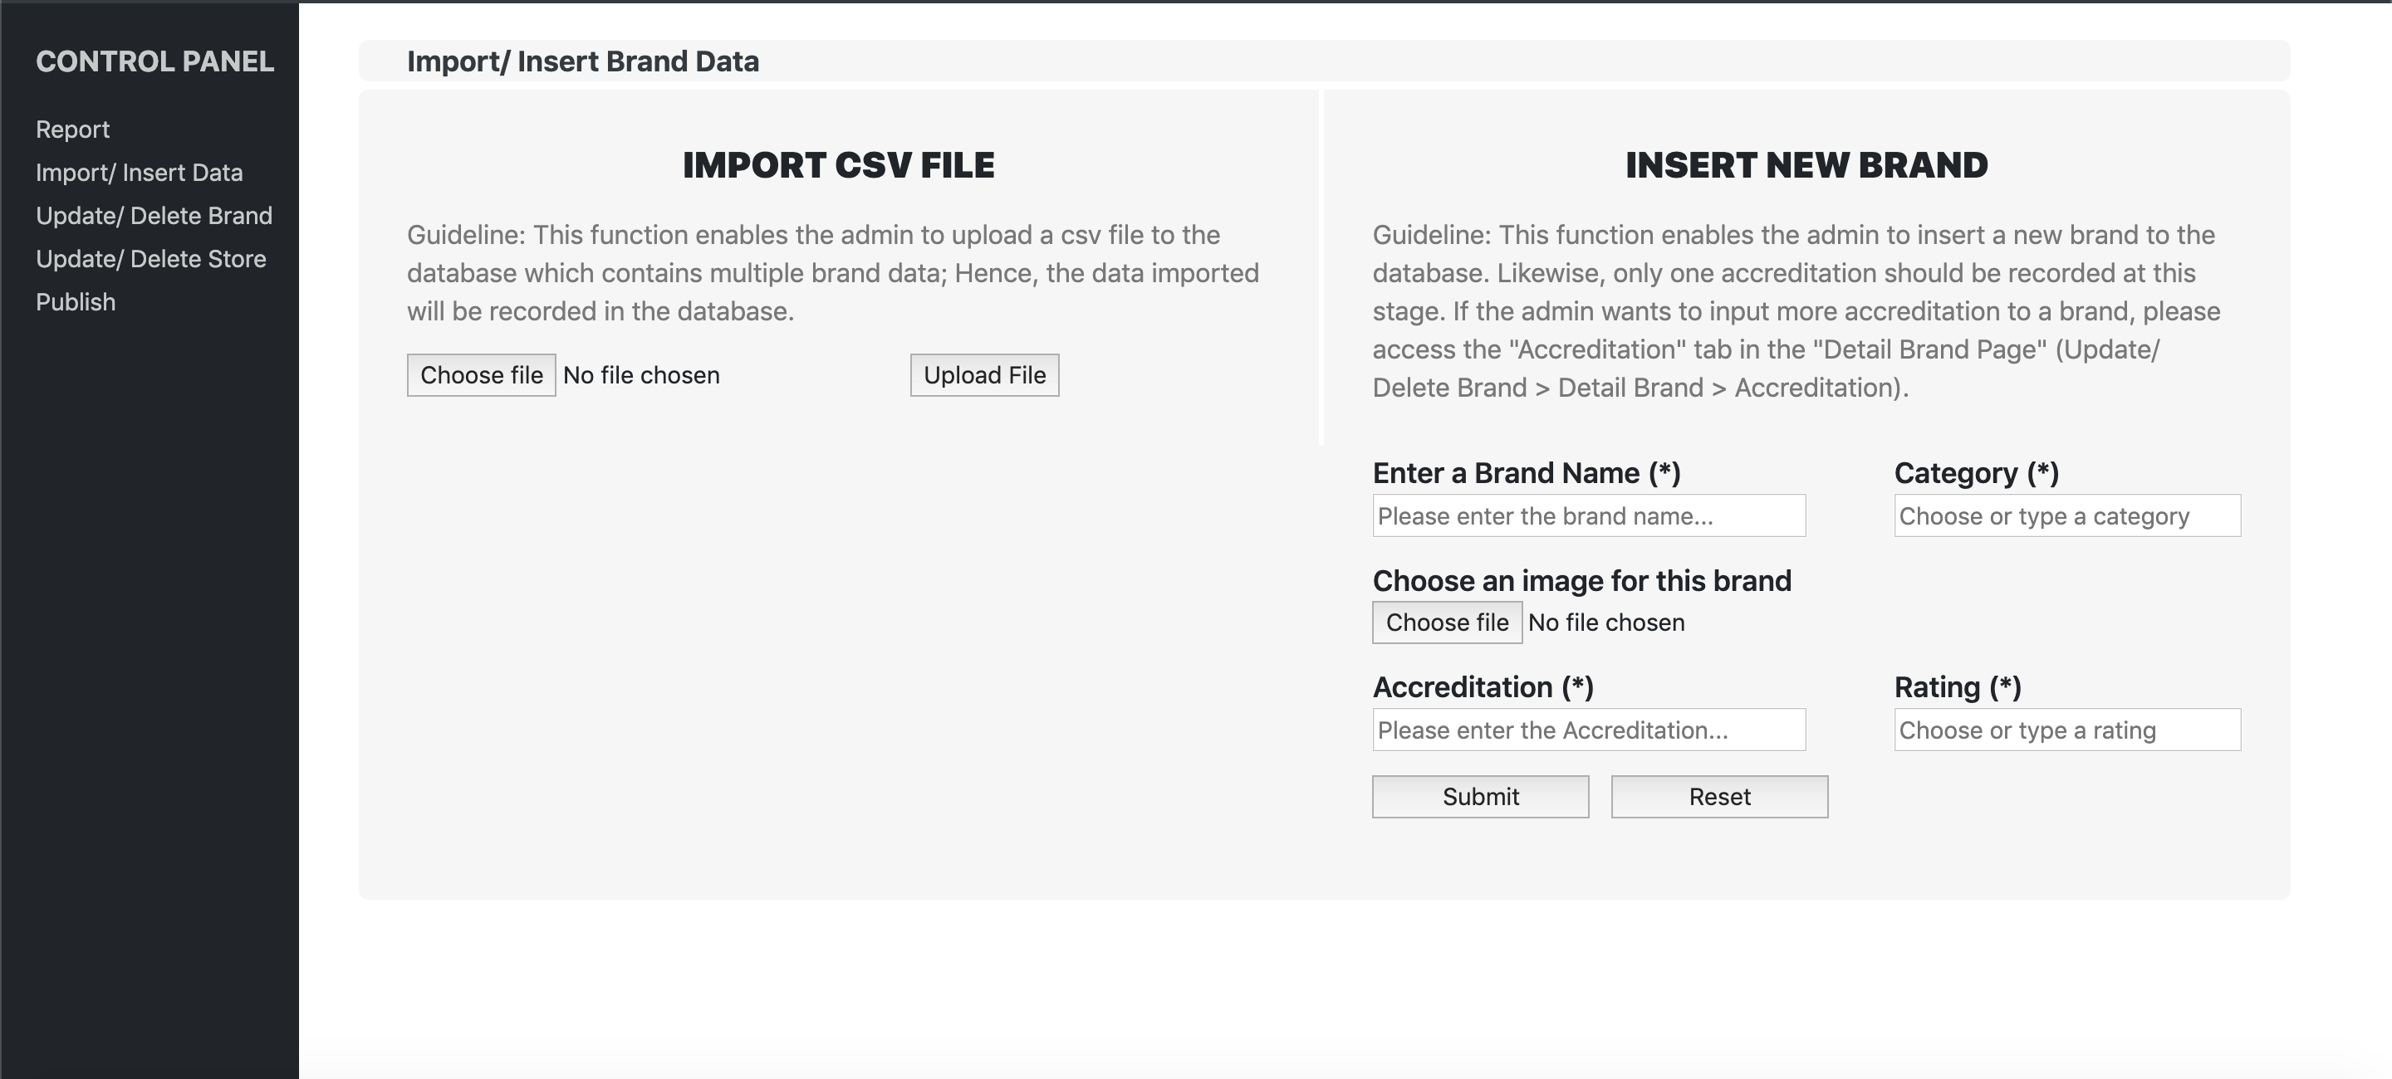
4
WEB-PAGE SERVER
Import/ Insert data
Admin can import brands/stores by csv file or insert them manually.

Slide 27
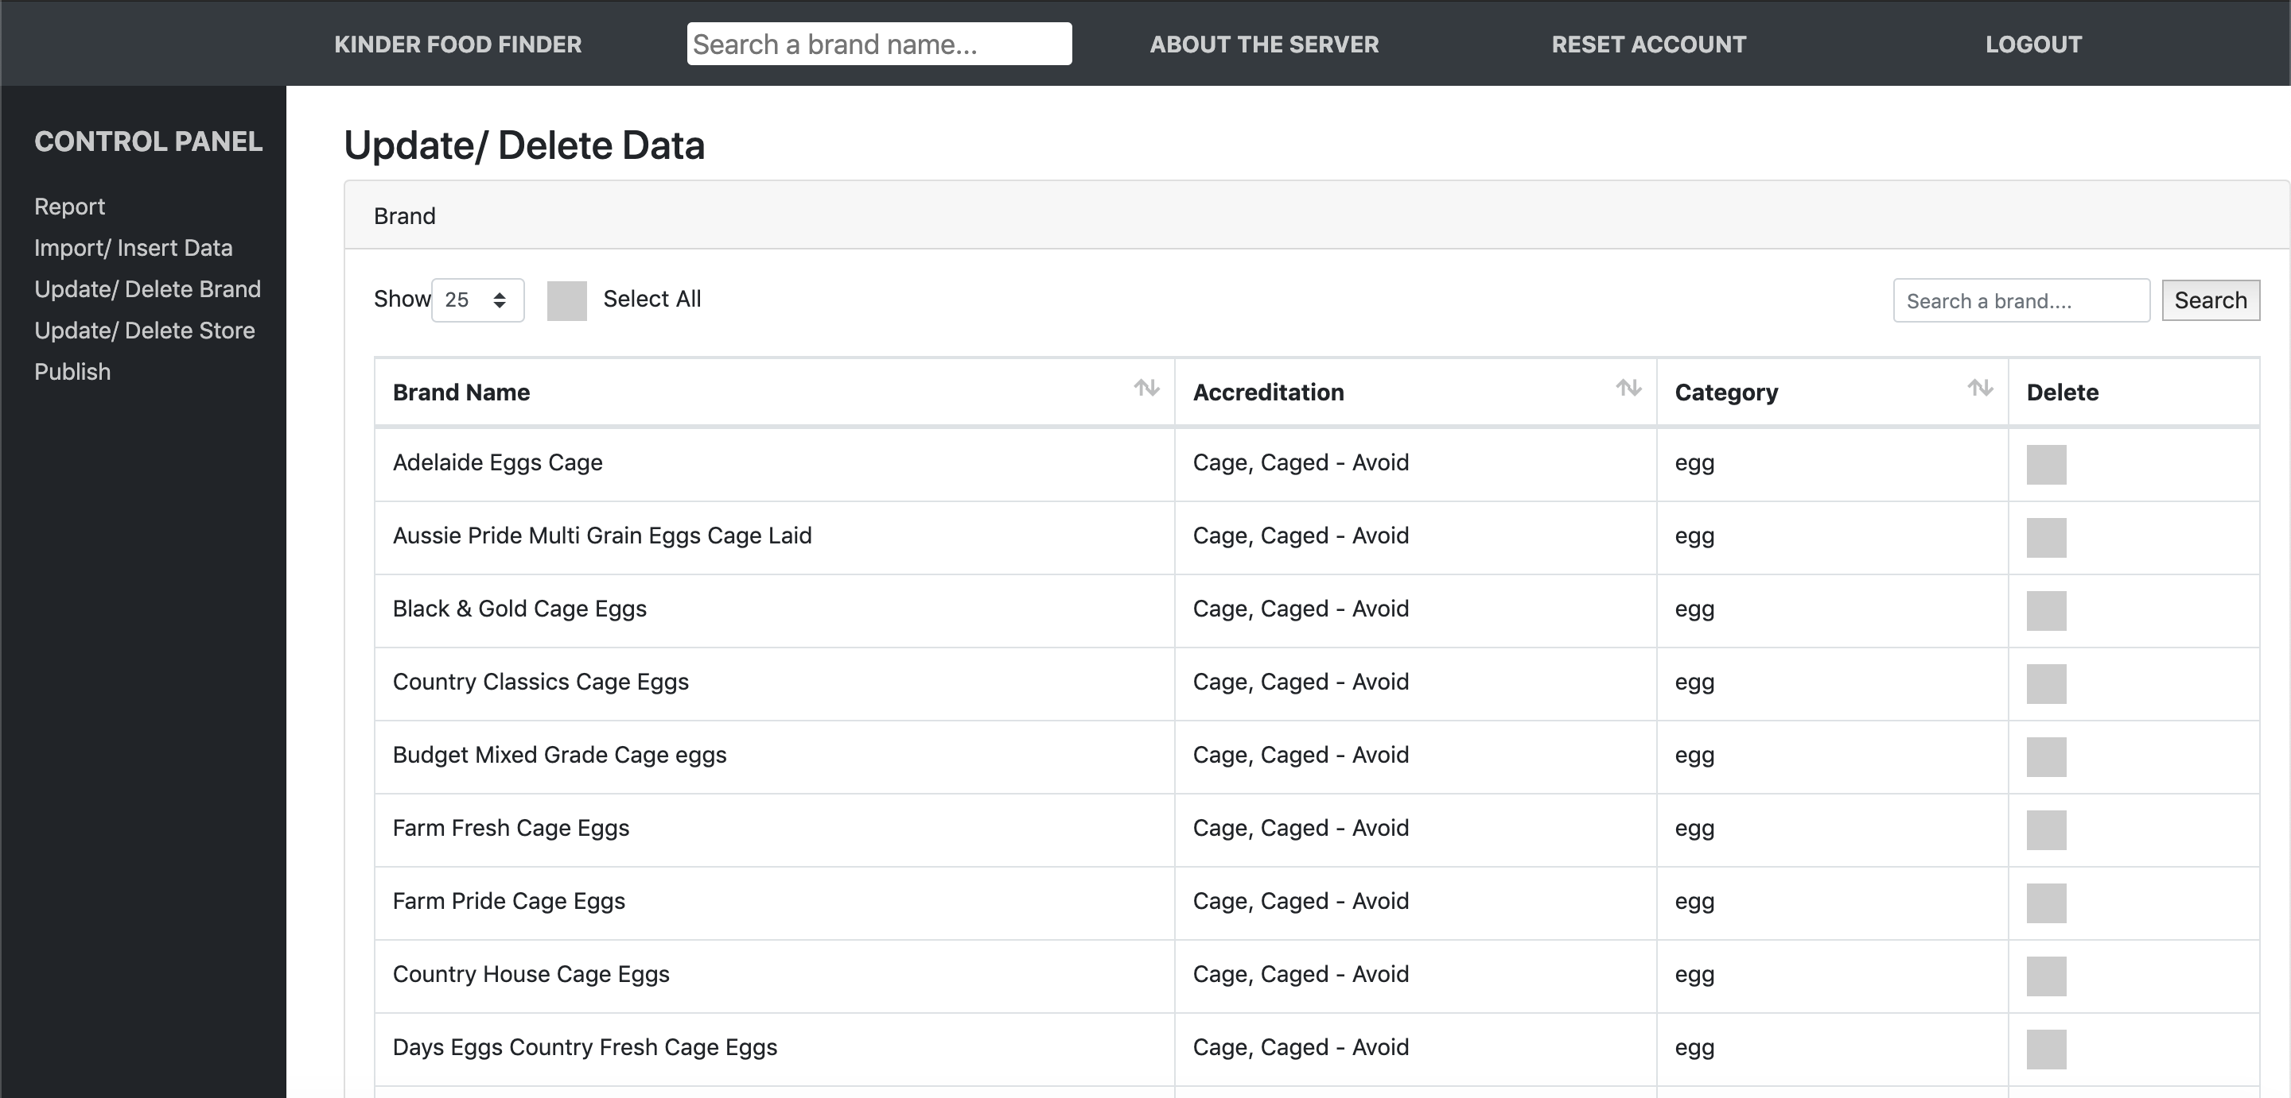
4
WEB-PAGE SERVER
Update/ Delete brand store (1/2)
Admin can view all the existing brands/stores in the database in such table views.

Slide 28
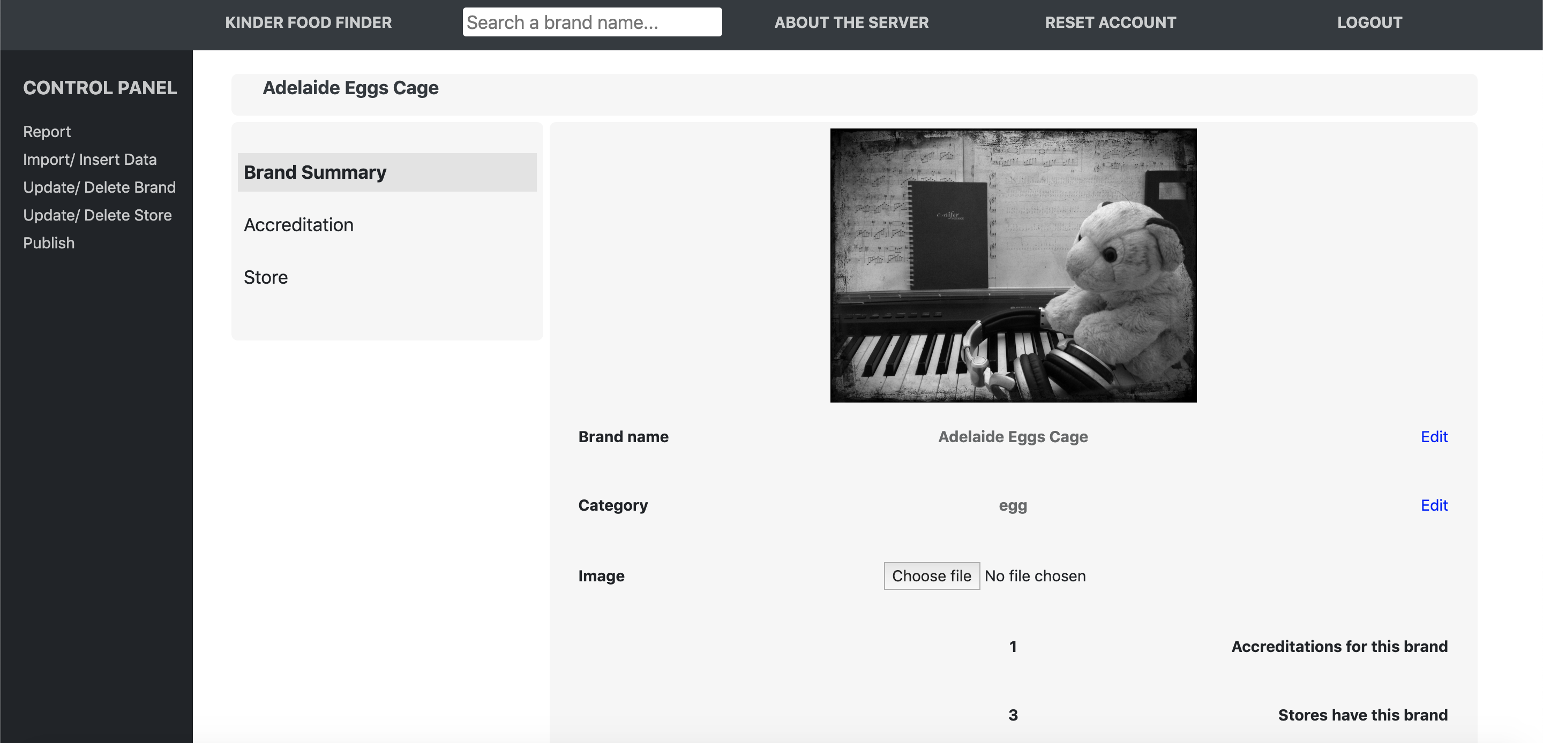
2
KINDER FOOD FINDER SYSTEM
Server – Update/ Delete brand store (2/2)
Admin can see the detail of a brand/store after clicking on them in the table.

Slide 29
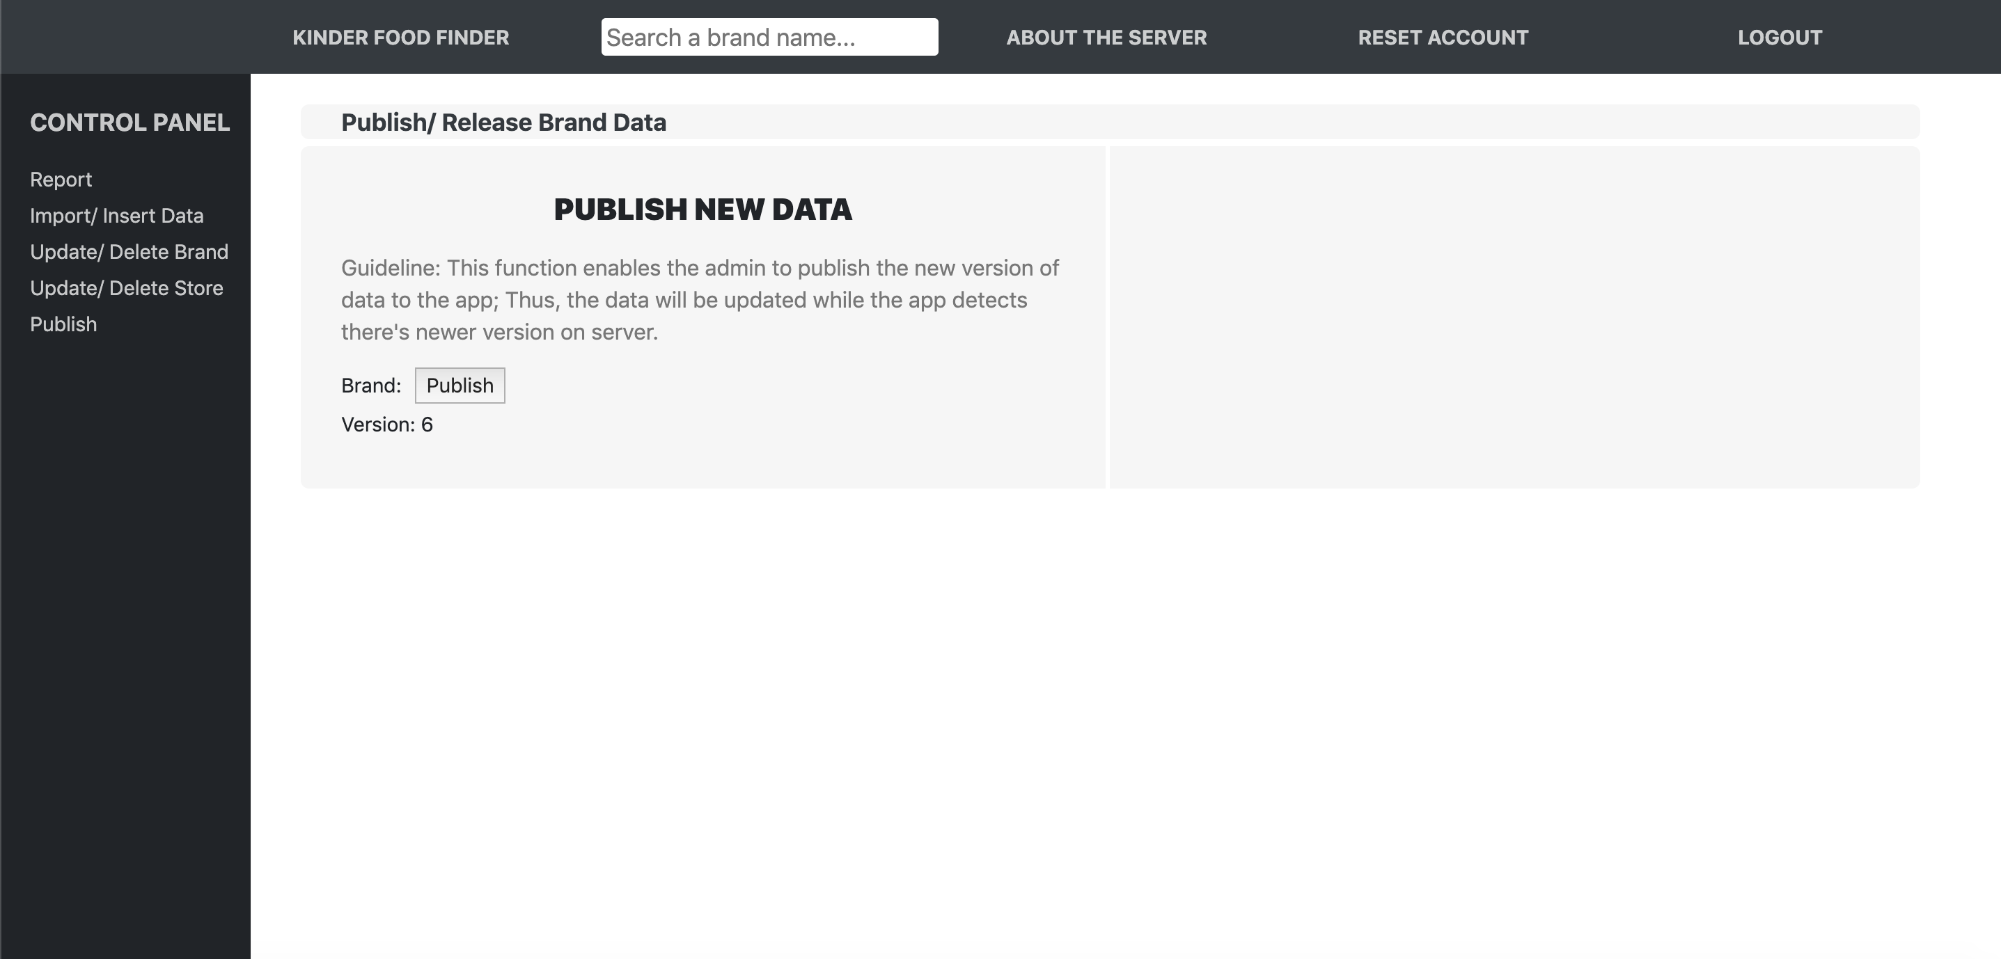
4
WEB-PAGE SERVER
Publish
Admin can publish the new version of brand/store database if any change applied.

Slide 30
TABLE OF CONTENT
1. | PROJECT BACKGROUND
2. | KINDER FOOD FINDER SYSTEM
3 | MOBILE APPLICATION
4 | WEB-PAGE SERVER
5. | CONCLUSION/ NEXT STEPS

Slide 31
5
Conclusion / Next Step
By providing an information channel about animal-welfare the project helps close the consumers’ intention and behaviour gap.
Deliverables of the project: Mobile application and Web-page server
Next step: The client will deploy the system.

Slide 32
Thank You
ANY QUESTIONS?

